Slide 1
Medical RAG Assistant Healthcare

Slide 2
Outline
Problem Statement
Proposed Solution
Tech stack
Workflow Diagram
Methodology
System Architecture
Streamlit App Demo
Code Module
Challenges and Learning
Conclusion

Slide 3
Problem Statement
Accessing reliable and structured medical information is challenging for both patients and professionals. Online sources are often unverified, and general AI models may provide misleading or hallucinated answers.
There's a growing need for a domain-specific assistant that can provide accurate, trustworthy responses by grounding answers in real medical datasets.

Slide 4
Proposed Solution
We built a Medical RAG Assistant that combines a local large language model with a vector-based document retrieval system to answer medical questions accurately and contextually.
By leveraging a real medical QA dataset, Sentence Transformers for embeddings, and a retrieval-augmented generation (RAG) architecture, the system delivers trustworthy, verifiable answers through a user-friendly Streamlit web interface.

Slide 5
Tech Stack
Dataset:Hugging Face's Medical Question Answering Dataset
Embeddings: sentenceTransformers ( all-MiniLM-L6-v2 ) for generating vector representations of questions & answers)
Vector Search: FAISS for fast and efficient similarity-based retrieval
Language Model: a domain-specific large language model, run locally
User Interface:streamlit for interactive web-based medical question-answering

Slide 6
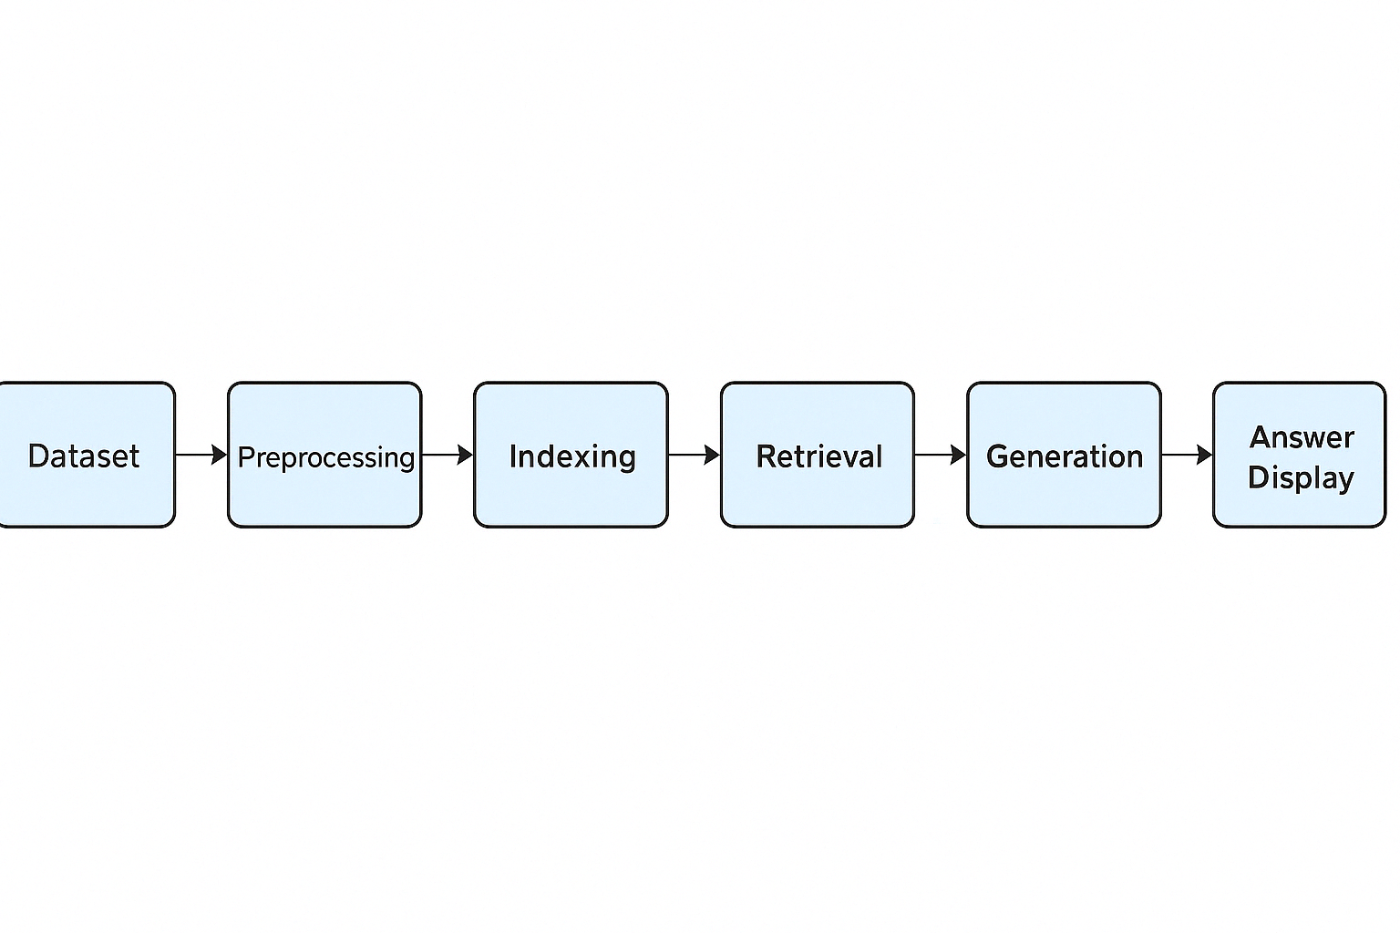
Workflow Diagram
Medical QA dataset is sourced from Hugging Face ( all-processed config).
Cleans and formats question-answer pairs into structured documents with metadata.
Generates vector embeddings using SentenceTransformer and builds a FAISS index for fast search.
Fetches the most relevant documents based on user query using vector similarity.
Passes retrieved context and query to the Med-Qwen2-7B model to generate a precise answer.

Slide 7
Methodology
1. Dataset Acquisition & Exploration:
Loaded a medical QA dataset from Hugging Face and explored its structure and quality.
2. Data Preprocessing:
Transformed raw question-answer records into clean, formatted documents with metadata for RAG.
3. Embedding Generation:
Used sentenceTransformer to convert documents into numerical vectors for semantic search.
4. Index Creation:
Built a FAISS index to enable fast, similarity-based retrieval of relevant context.
5. Question Answering via RAG:
Retrieved top documents based on user input and passed them, along with the query, to a local LLM for answer generation.

Slide 8
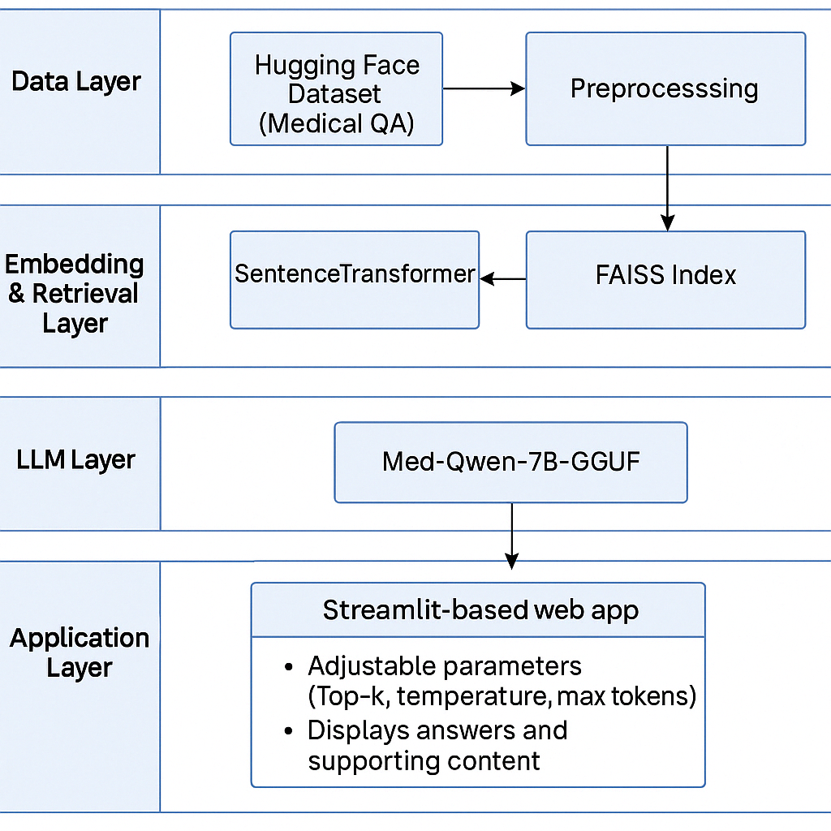
System Architecture
Data Layer:
Hugging Face Dataset (Medical QA)
Preprocessing with pandas for structured document creation
Embedding & Retrieval Layer:
SentenceTransformer model generates dense vectors
FAISS Index stores and retrieves similar documents
LLM Layer:
Med-Qwen2-7B-GGUF model (runs locally via llama-cpp or transformers )
Generates responses using retrieved context
Application Layer
• Streamlit-based web app for interaction
• Adjustable parameters (Top-k, temperature, max tokens)
• Displays answers and supporting content

Slide 9
Results
Successfully retrieved and processed over 50,000+ medical Q&A pairs
Generated accurate, context-based responses using a Retrieval-Augmented Generation pipeline
Achieved real-time response generation via locally run LLM (Med-Qwen2-7B-GGUF)
Demonstrated seamless integration of data preprocessing, retrieval, and answer generation through aweb interface
Application responds to a wide range of medical questions with high relevance and clarity

Slide 10
Conclusion & Future Scope
Conclusion
This project demonstrates how domain-specific QA systems can be enhanced using Retrieval-auqmented Generation (RAG)
By combining a medical QA dataset with local LLM inference, the system delivers explainable and fast answers
Future Scope
The current model occasionally gives vague or generic responses. Fine-tuning with curated medical data can significantly improve precision and reliability.

